Slide 1
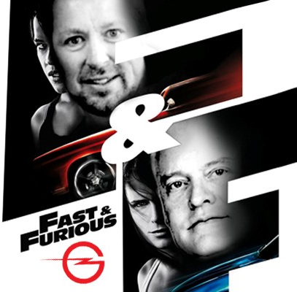

TURBO
CHARGED
MARKETING Trends for 24/25
CECU 2024 (Indianapolis, IN)

Slide 2
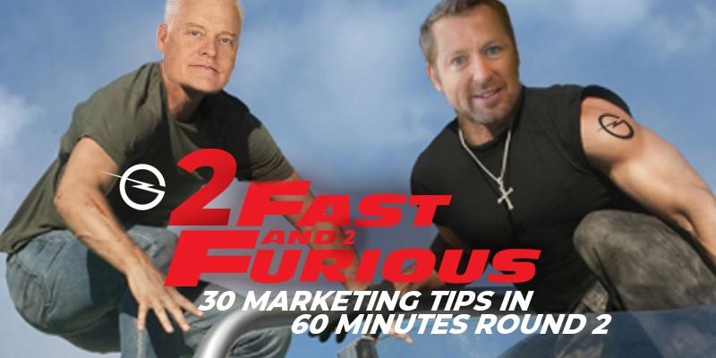


Today’s Presenters
Special Appearance by
Need photo of Fred
Greg “Diesel” Gragg
Chairman
Gragg Advertising
Fred Frantz
COO
Gragg Advertising
Darryl “Walker” Mattox
President/CEO
Gragg Advertising
@GoWithGragg #GraggChat
Notes:
open rates about 20-30x per day and a daily use time of 30-40 minutes

Slide 3

Let’s get started!

Slide 4
AI Impacts All Marketing Channels
AI is being used in ad placement and targeting to optimize campaigns. By plugging in targeting parameters, IA can run parameters to assure you are reaching everyone within your target market.
AI is used in copywriting to make sure we are sticking with best practices and optimizing our language for each individual platform.
Third party schedulers (Hubspot, Sprout Social, etc) use AI to find the best times in each platforms algorithm to post organic content.
META and Google’s Search Generative Experience (SGE)
AI is used to assist in campaign building. By providing objectives, parameters, and budgets AI tools can give us a good starting point but still needs to be tweaked. AI can’t do everything. A marketing expert is still needed to oversee these tools.
A

Slide 5
Content Marketing
Content is still king.
Content needs to be reviewed and updated constantly.
Content needs to be VALUABLE, RELEVANT and CONSISTENT.
Develop EVERGREEN content for your website.
Content Marketing (videos, blogs, post, etc.) is the creation and sharing of online material that is intended to stimulate interest in a businesses products or services, and not specifically to promote a brand.
Write your content to the intent of the user and not just to keywords
Content should be seen as a conversation
Answer the user's query
Review and proof all content prior to posting/publishing.
Best AI Tools for Content Development
ClickUp
Narrato
Lately
Jasper
Copy.ai
Synthesia
HubSpot
SEMRush
D

Slide 6
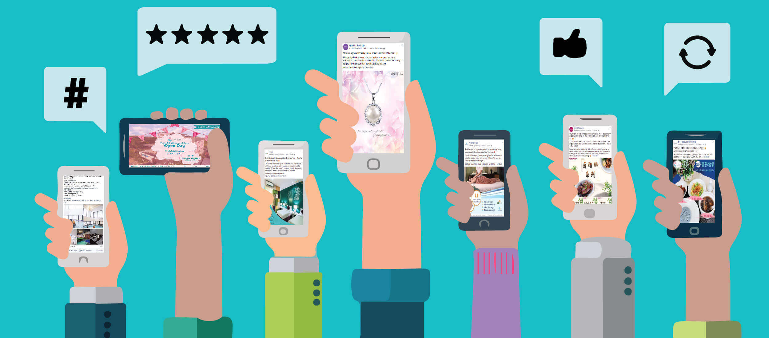
User-Generated Content (UGC)
UGC refers to any original, brand-specific content that’s created by customers and published on social media or other online channels. UGC can come in many forms, including testimonials, product reviews, images, videos, and all sorts of other formats.
User-generated content is a modern-day word of mouth. it’s normally a zero-budget production from an average, unrecognizable person.
Consumers are 3x more likely to say content created by a consumer is authentic compared to content created by a brand.
UGC is an excellent tool for building trust and can even influence purchase intent. Adweek data suggests that 85% of consumers believe that UGC is more influential than content made by brands.
User-generated content can bring a sense of creativity back to the marketing landscape and could be important to prevent generative AI burnout.
G

Slide 7

User Generated Videos (UGV)
UGV is one the most important pieces of UGC as it provides authenticity. Authenticity sells because user-generated content especially with video is key for consumer trust and relatability. User generated videos are created by users without any use of professional agencies or brands. They provide authenticity of the products as well as genuineness.
Provides genuine brand experiences from real customers
Increases brand awareness
Influences customer’s buying decisions
Enhances conversion rates
Improves the ability of decision-making quickly
Users get an overall idea about the brand within a few minutes
Improves website traffic
Builds brand image
Maintain control over what the influencer say in the ad – everything should go through the traditional approval process before posting.
F

Slide 8
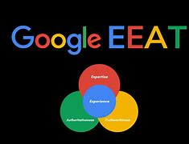
Google E-E-A-T
E-E-A-T is Google’s algorithm targeting online content. It stands for Experience, Expertise, Authority, Trust.
The originally Standard: E-A-T (Expertise, Authority, Trust )
Now that many are using A-I to create content, Google has put in place additional measures to combat cheap, low quality, questionable or ripped off content from A-I generated material
The new standard: E-E-A-T (Experience, Expertise, Authority, Trust). What this means is that brands need to tell their story, their experience, their journey and make the products, services more real to the public. This is becoming more important than ever to combat A-I generated content by humanizing the brand story as opposed to generic web copy.
D

Slide 9
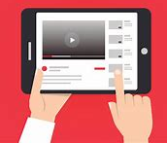
In-Stream Advertising
In-stream advertising refers to video ads that are played within a stream of content, such as a video on YouTube or a TV show on a streaming platform such as Pandora, Spotify, Max, Hulu etc.
Typically :15, :30, or :60 lengths running before, during, or after the main content.
Skippable or non-skippable.
The most common form of video advertising and comes in three forms: pre-roll, mid-roll, and post-roll.
Filters can be applied to the campaign for gender, age, sip-code, interests, etc. Making them efficient. Custom audiences can be set to further target. Purchased a home in the past 60 days or self-reported interest in continuing education.
CPM tends to be lower than linear TV and Radio. (Digital TV CPMs: $25-$60, Digital Radio CPMs $8-$20) Tracking pixels can be applied to the ads and advertiser websites to monitor performance and response to each ad.
G

Slide 10
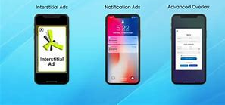
In-App Ads
In-app advertising (IAA) refers to the practice of displaying paid advertisements within a mobile app, allowing app owners to capitalize on their real estate by selling ad space to advertisers.
Advertisers benefit by showcasing their ads to a relevant and engaged audience within popular mobile apps.
With 5.25 billion mobile users worldwide as of 2023, having a well-defined mobile advertising strategy has become a necessity.
IAA is becoming an integral part of any comprehensive mobile marketing strategy.
The IAA market is projected to reach $314.5 billion in 2023. Today, millions of apps are available across mobile devices, users are spending increasingly more time in-app.
According to eMarketer, 88% of mobile usage is now spent in-app and average 5.5 hours per day. Several ad size options exist including banners, takeovers, native, playable, video, and others. Costs vary based on size and type of ad, app contracted popularity, sales demand, coverage, impressions contracted, etc.
A

Slide 11

Student Success
Story Videos
Students providing testimonials about their experience at your school and in the career field after graduation give you a credibility you can never achieve on your own.
YouTube, TikTok, Website, Instagram stories, Facebook reels, etc.
77% of people who have watched a testimonial video say it has played a part in their decision to use a product or service.
Success stories also allow students to picture themselves in the place of the successful student.
Stories create a stronger impression in targets’ minds than simple statements of fact.
D

Slide 12
Voice Search Optimization
With the increasing prevalence of voice-enabled devices and virtual assistants, optimizing content for voice search will become paramount. SEO professionals will need to adapt their strategies to accommodate natural language queries and conversational search patterns.
20% of Google App searches are conducted by voice
50% of U.S. consumers use voice search every day
Voice searches are longer than text-based searches, on average
Experts forecast that by the end of 2024, voice search queries will increase to 2 billion per month
Weekly voice searches are a habit for 21% of people ages 25-49
Google has broken language barriers, offering mobile voice search in over 60 languages.
Voice search answers are short, around 29 words.
People are asking questions in nearly 10% of voice searches.
Voice makes up 20% of mobile queries.
50% of all searches were voice-based in 2021
Source: LinkedIn
D

Slide 13

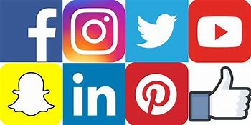
Cross Posting on Multiple
Social Media Platforms
Posting to multiple social media platforms will make sure that you have reached all/most of your target audience.
Each social media platform is different. Content for each platform should be different. Version each post to match the features of the platform. For example, use hashtags on IG, links on Facebook and LinkedIn etc.
Understand the different audience by platform. LinkedIn is higher level, more educated. Instagram tends to be younger. Facebook is a more general audience in education and age.
G

Slide 14
Dynamic Social
Media Campaigns
Plugging in more than one set of creative and copy into your campaign. The algorithm will take into consideration your targeting parameters and put together the ideal combo to serve to your audience.
This can improve your engagement, CTR and extend the life of your campaign.
Frequency rate – a metric we use to track the efficacy of our creative and copy. As the number goes up, efficacy goes down. Using dynamic campaigns extends the time between swapping out creative and copy.
Campaigns will be more tailored to each person.
Use in the beginning of a creative swap, A/B testing is still important.
Pay attention to your cost per click. This will give you insight into whether or not your creative is working.
F

Slide 15
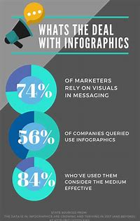
Infographics
Infographics simplify complex information into easily digestible and visually appealing formats.
People retain 4x as much information from visual content than text alone.
They grab and hold attention, which makes them useful for social media and other creative platfoms
The human brain processes visual information 60x faster than written information, which facilitates the sales closing process.
D

Slide 16

Singular Focused
Landing Page Goal
When developing a landing page the singular focus of your landing page should be: Conversion
Landing pages should be set up for visitors to take a single action eliminating bleeds off the page or multiple link outs where visitors leave the page without much chance of converting.
Landing pages should be designed to convert organic traffic.
G

Slide 17
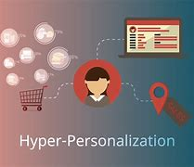
Hyper-Personalization
Hyper-personalization is a combination of marketing and data analytics. It’s a process whereby marketers combine real-time customer data from multiple touchpoints and channels to create an ultra-detailed, per-customer marketing strategy.
Data makes it possible to deploy customized advertising, products, services, and offers for each customer. This is possible thanks to the latest developments in AI technology, which uses machine learning and deep learning to analyze real-time data about customers, looking for patterns that could indicate what each customer is looking for.
This deeper understanding of a customer’s intentions allows a brand to be in the right place at the right time.
F

Slide 18
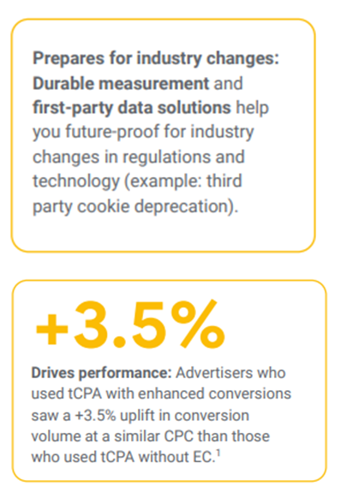
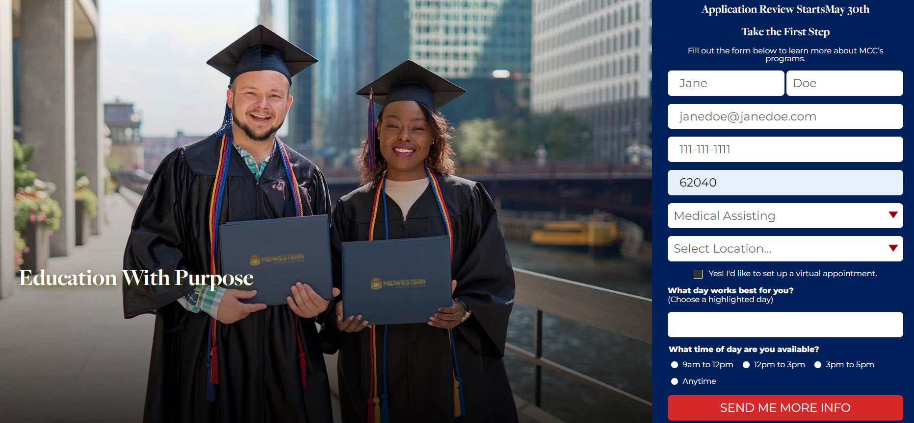
Enhanced
Conversion Tracking
Improve the accuracy of your conversion measurement and unlock more powerful bidding opportunities. Enhanced conversions allows you to collect first-party data for online conversion actions like a form fill along with offline conversion actions (application, enrollment, start).
D

Slide 19
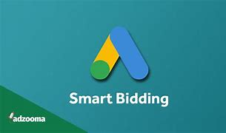
Google Smart Bidding
Strategy Optimization
With the enrollment journey process being more complex based on changing consumer behaviors,
leverage Google Ads AI to optimize for conversions or conversion value through various smart bidding strategies to align with your marketing goals and objectives
Conversion Based Bidding Strategies
    Target Cost Per Acquisition (Target CPA)
Value Based Bidding Strategies
Targeted Return on Ad Spend
Maximize Conversion Value
G

Slide 20
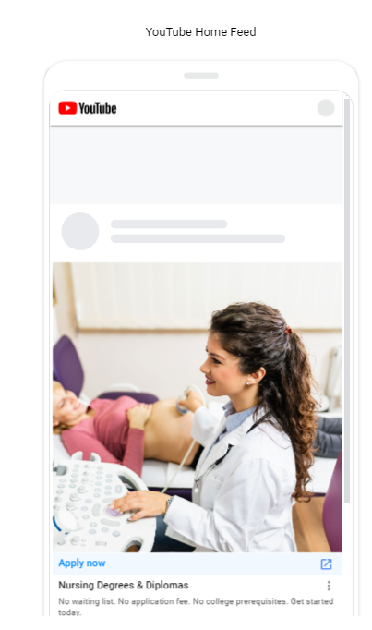
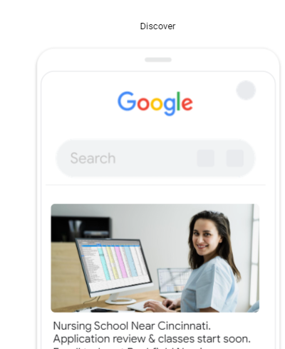
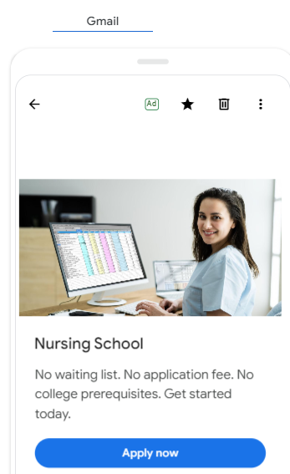
Demand Gen Ad Solutions
Demand gen is a Google Ads network campaign that captures engagement and action across YouTube (including YouTube Shorts) and Google’s most immersive, visual touchpoints using audience-first creative assets and images that drive demand through effective measurement
Up to 86% of online users spring into immediate action after discovering something new on YouTube or Google¹
¹Source: Google/Ipsos, Video & Social Ad Impact Study July 2023-August 2023, online survey of online users 18-54 who use social apps/sites monthly or more often (social apps/sites: Discover, YouTube, YouTube Shorts, Gmail, Facebook, Instagram, TikTok, Twitter, Snapchat
F

Slide 21
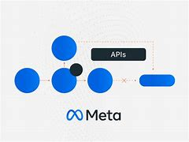
META CAPI
META CAPI is an API made available by Meta that allows you to send conversion data directly from your server to Facebook's server. It helps fill the void left by third-party cookie deprecation and results in more sophisticated data for creating programmatic campaigns.
Designed to create a direct connection between your marketing data and Meta to optimize targeting and decrease CPA (action).
Using website conversions is integral to tracking the progress and success of your campaign. CAPI is the latest, and best way to track these events.
To set up correctly, working with a developer is highly recommended. You will need access to the backend of your website.
D

Slide 22
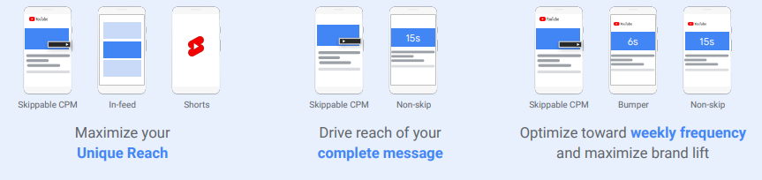
Video Reach Campaigns
Video Reach campaigns can help optimize your video assets through appropriately choosing your YouTube target audience, discovering the correct ad combinations, analyzing key performance metrics to maximize your audience reach potential and build brand awareness
Advertisers using two or more brand formats resulted up to a 9% increase in conversions¹
¹Source: Google internal data, 56,000 active advertisers with multi-touch conversion paths including video, August 2021-October 2021
G

Slide 23

Virtual Appointment Setting
Virtual appointment setting makes potential students feel more in control and more comfortable with the admissions process.
“Higher intent” leads for prospective students wanting to connect with admissions via a virtual appointment.
Roughly 25% of PPC form fills request virtual appointments in 1st month while up to 45% of PPC form fills request virtual appointments after 90 days of implementation.
Virtual appointment request conversions result in higher conversions.
F

Slide 24
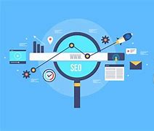
Video/Photo
Online Optimization
Optimize photos and videos with proper meta descriptions, metadata, transcripts, and proper file names.
Ramp up video/photo optimizations similar to content optimizations.
D

Slide 25
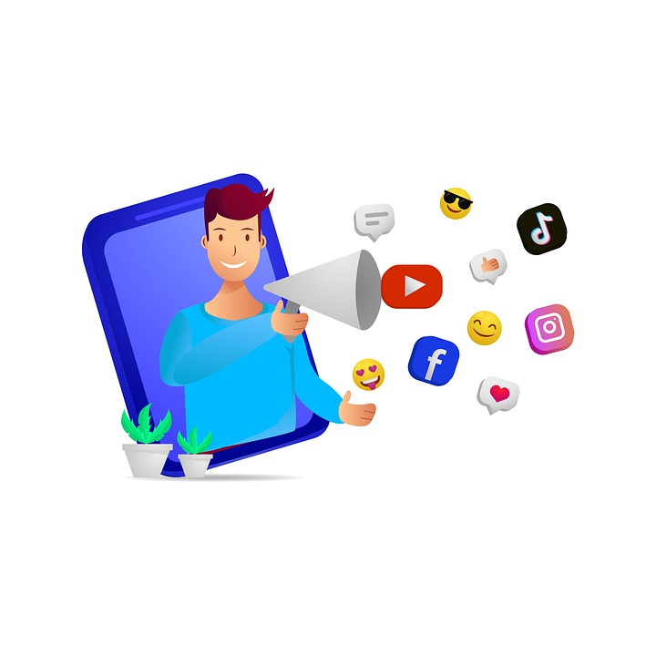
Influencer Marketing
AI Continues to Impact Influencer Marketing.
76% of Marketing Agencies and 52% of Influencers are using AI.*
The Expansion of TikTok
Gen Xer’s are rapidly adopting TikTok but only 5% of the marketing is aimed at this group.
Focus on Your Niche
TikTok, YouTube, Instagram and Facebook are saturated with generalist.
LinkedIn is Seeing Record Levels of Engagement
Create lasting content such as Career Opportunity reports.
Back it with the support of multiple influencers provides great leverage and amplification.
* Forbes Magazine, Feb 2024
G

Slide 26
Performance Metrics
2023 Performance
Media CPI Conversion
SEM (PPC/SD) $75 - $225 3 - 7%
Pay Per Lead (PPL) $45 - $60 1 - 2%
Digital/Traditional
Radio and TV $400 - $600 8 - 10%
Website $25 - $45 7 - 10%
2024 Expectation
Media CPI Conversion
SEM (PPC/SD) $80 - $230 3 - 7%
Pay Per Lead (PPL) $50 -$70 2 - 3%
Digital/Traditional
Radio and TV $500 - $700 8 - 10%
Website $30 - $50 8 - 11%
F

Slide 27
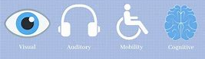
ADA Website Compliance
To comply with ADA guidelines for websites, you should:
Ensure all content on the website is presented in an easily perceivable manner for all users.
Ensure all site functions and navigations are operable by all users, including keyboard-only commands.
Ensure all content is easy to understand and comprehend for all users.
Ensure your website functions well with a large variety of assistive technologies for disabled users.
Emphasize contrast in your website design.
Keep sentences short and simple.
Use simple terms instead of industry jargon.
Post an accessibility statement with contact information for support.
Follow the Web Content Accessibility Guidelines (WCAG) checklist for ADA compliance.
D

Slide 28
Automated Compliance Management
AI - State’s have already started to regulate the impact. Every regulator will want a piece of it. Usually, one regulator owns the issue. Congress may determine if there is one AI standard to minimize confusion.
Always disclose AI usage and how it makes decisions e.g Student selection via AI is a “No No”
Semantic ( looks for the meaning) search you can uncover content that portrays a more accurate finding vs having to search for buzz words or rely solely on links.
The images are involved in searches which is great for logo and product searches where scammers have hidden the code.
One to One consent is paramount.
Rule sets for everyday compliance
G

Slide 29
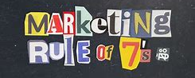
Marketing Rule Of Seven
The Rule of 7 is that a potential customer will need to be exposed to a brand's marketing messages at least seven times before they are ready to make a purchasing decision
This principle emphasizes the importance of repeated exposure for enhancing recognition and improving retention
Today you might need more than those 7 times just to be heard above all the marketing (and other) clutter in the consumers field of vision
Without a clearly-defined marketing strategy to determine how to touch a prospect at least 7 times, your odds of success are greatly diminished
D

Slide 30

Thank you.
Any questions? Please contact us at Graggadv.com or info@graggadv.com
@Gowithgragg #GraggChat
@GraggAdvertising
All information, strategy and messaging contained and included within this presentation is the sole and complete property of Gragg Advertising. Any execution or use of this information without the authorization or permission of Gragg Advertising is an infringement and violation of proprietary and confidential contained, arranged and owned in this presentation by Gragg Advertising.

Slide 31
User Experience (UX) Trends
Dark Mode: The use of dark mode in user interfaces continues to rise. It reduces eye strain and enhances visual appeal, making it a preferred option for many users and designers
Data-Driven Design: Utilizing user data such as heat mapping to inform design decisions ensures that interfaces meet the specific needs and preferences of users. This approach includes personalized data visualization and more interactive data displays
Generative Design: AI-driven generative design tools are helping to streamline the design process by automating elements like layout, icon selection, and even content creation. These tools aid designers in creating more efficient and user-friendly interfaces
Bold and Oversized Typography: Large, striking fonts are used to grab attention and convey messages clearly. This trend emphasizes readability and aesthetic impact, often seen in landing pages and promotional content
A

Slide 32
User Interface (UI) Trends
Clean User Interfaces with a Twist: While clean and minimalist designs remain popular, adding unique visual twists can make interfaces more engaging. This might include unexpected color gradients or dynamic elements within a minimalist framework
Glassmorphism: Characterized by translucent, frosted-glass elements, this design style gives a sleek, layered look. It involves background blurs and transparent overlays to create a sophisticated, three-dimensional effect
Microinteractions: Small, subtle animations that provide feedback and improve user experience are gaining prominence. These can include hover effects, button animations, and notifications, enhancing the interactivity and intuitiveness of an interface
Bento Box Design: Inspired by the Japanese lunchbox, this layout organizes content into neatly arranged, modular boxes, making interfaces cleaner and more visually appealing
A

